Slide 1
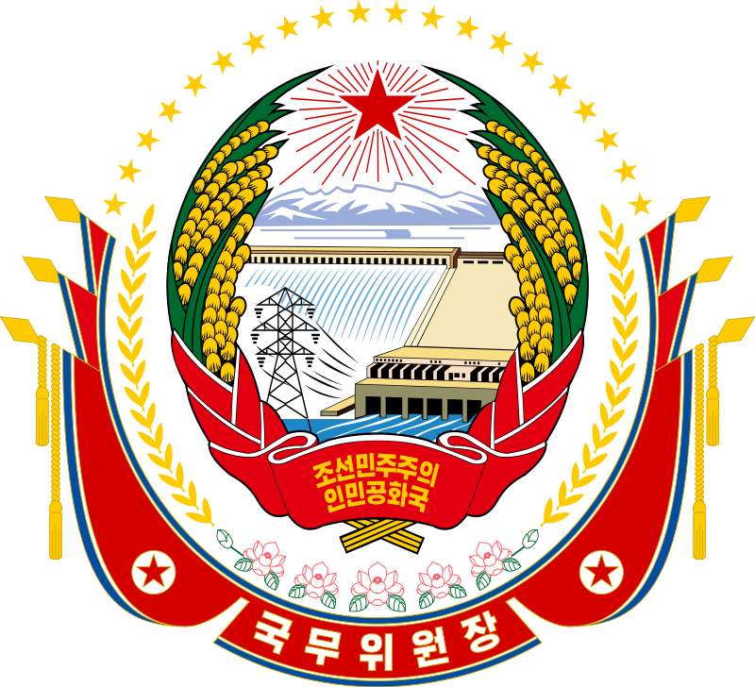
2018년 북미정상회담
2018 North Korea–United States Singapore Summit

Slide 2
In brief
The 2018 North Korea–United States Singapore Summit, commonly known as the Singapore Summit, was a summit meeting between North Korean chairman Kim Jŏng-ŭn and U. S. president Donald Trump, held at the Capella Hotel, Sentosa Island, Singapore on June 12, 2018. It was the first-ever meeting between leaders of North Korea and the United States.
They signed a joint statement, agreeing to security guarantees for North Korea, new peaceful relations, the denuclearization of the Korean Peninsula, recovery of soldiers' remains, and follow-up negotiations between high-level officials.
Immediately following the summit, President Trump announced that the U. S. military would discontinue "provocative" joint military exercises with South Korea, and stated that he wished to bring the U.S. soldiers back home at some point, but he reinforced that it was not part of the Singapore equation.
On August 1, 2018, the U. S. Senate passed the military budget bill for 2019, forbidding funding the reduction of active US Forces in Korea (USFK) personnel below 22,000; significant removal of US forces is considered a non-negotiable item in denuclearization talks with the North.

Slide 3
In brief
After a period of heightened conflict that included North Korea successfully testing what it claims was its first hydrogen bomb and the Hwasŏng-15 intercontinental ballistic missile (ICBM) in late 2017, tensions began to de-escalate after Kim Jŏng-ŭn announced his desire to send athletes to the 2018 Winter Olympics being held in South Korea.
During the games, Kim proposed talks with South Korea to plan an inter-Korean summit.
On March 8, the South Korean delegation returned from the talks and traveled to the United States to deliver an invitation by Kim Jŏng-ŭn to Donald Trump for a meeting. High-level exchanges between the two sides then took place, including a visit by then-CIA director Mike Pompeo to Pyongyang and a visit by Kim Yŏng-chŏl (김영철), vice chairman of the Central Committee of the Workers’ Party of Korea, to the White House.
Both sides threatened to cancel the summit after a round of joint military exercises by the U.S. and South Korea, with Trump even delivering a formal letter to Kim to call off the meeting; however, the two sides eventually agreed to meet.
A second meeting was held between Trump and Kim in February 2019 in Hanoi, Vietnam.

Slide 4
Hwasŏng-15 / 화성 15호 / 火星

Slide 5
Background
Donald Trump was elected US president in 2016 with a position of opposition to Barack Obama’s policy of "strategic patience” towars North Korea. While advocating a tough stance, he also expressed openess to dialogue, saying he would be prepared to "eat a hamburger” with Kim Jŏng-ŭn. He put himself at odds with military allies, saying that it would be better if South Korea and Japan protect themselves. In return, a pro-North Korean website, DPRK Today, described him as a "wise politician”. The editorial suggested that Trup might make tje slogan „Yankee go home” a reality. In 2017, Mun Jae-in (문재인) was elected president of South Korea with a promise to return to the Sunshine Policy of friendly relations with the North.
During a period of heightened tensions with the United States, North Korea successfully tested its first Intercontinental ballistic missile (ICBM), named Hwasŏng-14, in July 2017. In response to heightened North Korea rhetoric, Trump warned that any North Korean attack "will be met with fire, fury and frankly power, the likes which the world has never seen before”.
In response, North Korea announced that it was considering a missile test in which the missiles would land near the US territory of Guam. North Korea tested what some sources argued nay heve been its first hydrogen bomb on September 3, 2017. The test was internatinally condemned, and further economic sanctions were put on North Korea.
The United States also added North Korea back to its State Sponsors of Terrorism list after nine years.

Slide 6
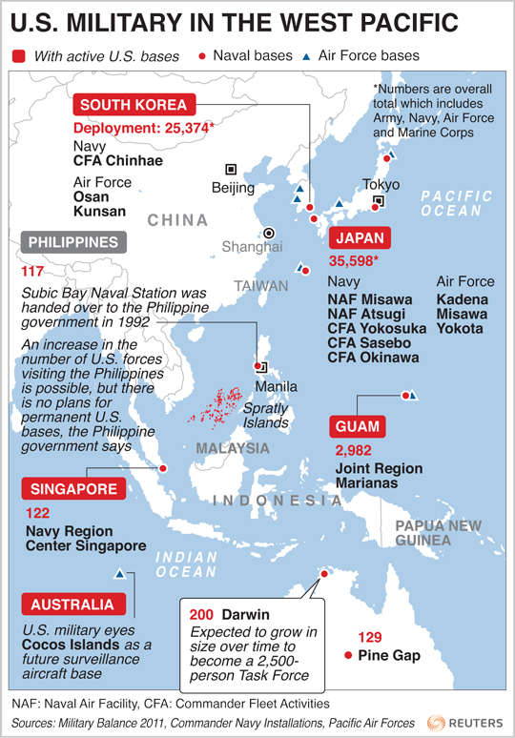
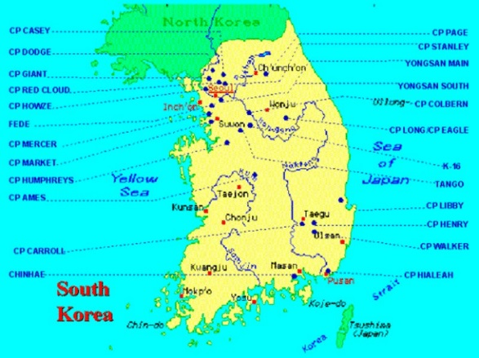
U. S. military presence in the West Pacific

Slide 7
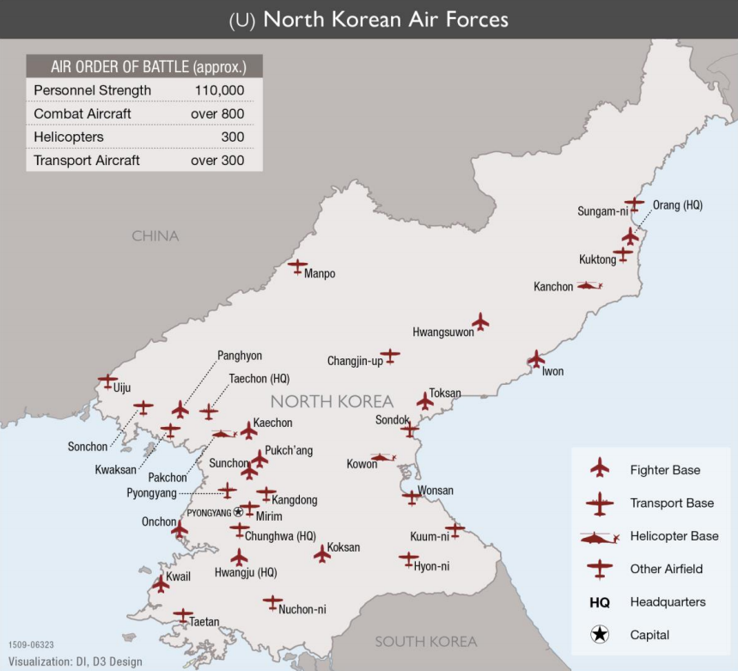
Military force on the Korean Peninsula

Slide 8
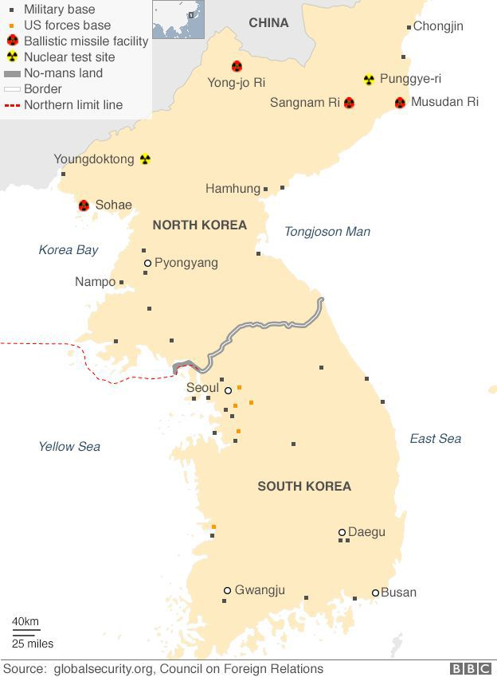

Slide 9
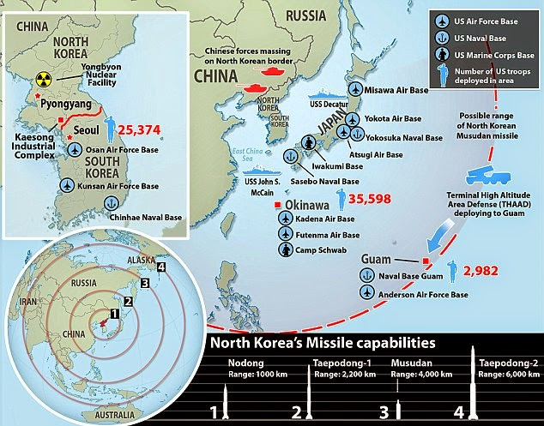
U.S. bases in East Asia (대한민국, 沖縄本島) and West Pacific

Slide 10
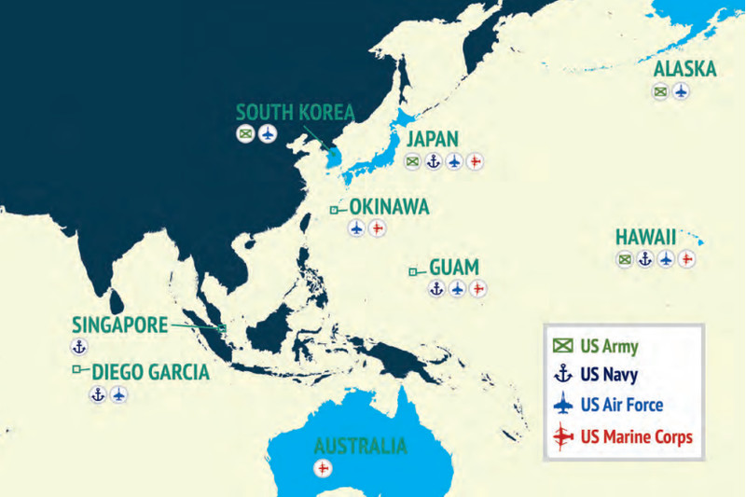
U. S. army in the Indo-Pacific theater

Slide 11
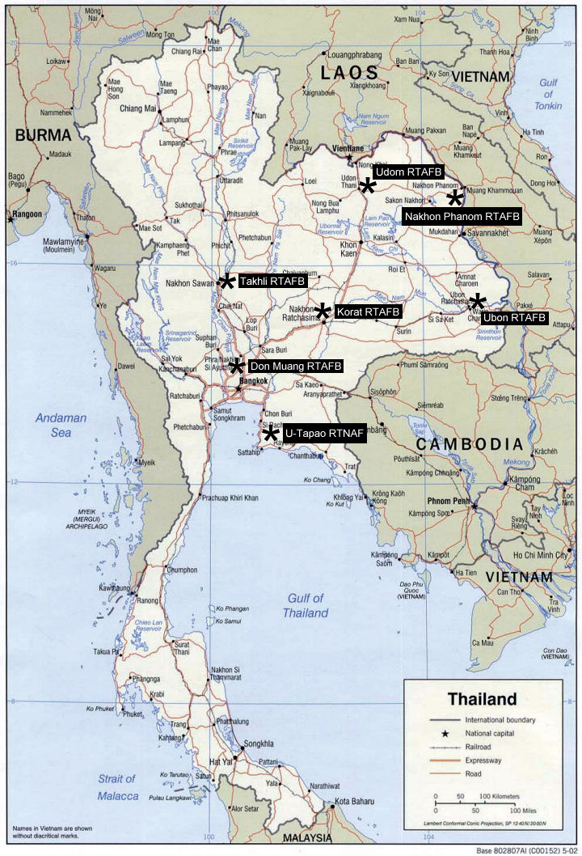
U. S. military bases in the Indo-Pacific area

Slide 12
Background
On November 28, 2017, North Korea launched the Hwasŏng-15, which, according to analysts, would be capable of reaching anywhere in the United States. The United Nations responded by placing further sanctions on the country. After North Korea claimed that the missile was capable of "carrying [a] super-heavy [nuclear] warhead and hitting the whole mainland of the U.S.”, Kim Jŏng-ŭn announced that they had "finally realized the great historic cause of completing the state nuclear force”, putting them in position of strength to push the United States into talks.
In his New Year address for 2018, North Korean chairman Kim Jŏng-ŭn celebrated completing their nuclear capabilities and proposed talks for sending a delegation to the upcoming Winter Olympics in South Korea.
In January a false missile alert alarmed Hawai’i.
The Seoul-Phyongyang hotline was reopened after almost two years. North Korea sent as unprecedented high-level delegation, headed by Kim Yŏ-jŏng (김여정), sister of Kim Jŏng-ŭn, and Kim Yŏng-nam (김영남), chairman of the Presidium of the Supreme National Assembly. The delegation passed on an invitation to president Mun to visit North Korea. The United States was represented by vice president Mike Pence.

Slide 13
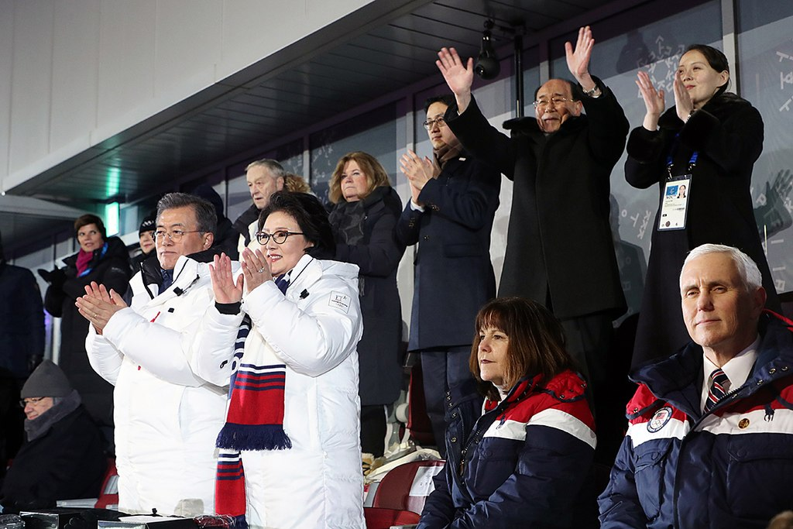
Mun Jae-in, Mike Pence, Kim Yŏ-jŏng and Kim Yŏng-nam in Phyongchang

Slide 14
Background
On March 5, 2018, South Korea's special delegation agreed to hold the third inter-Korean summit at Inter-Korean Peace House in Phanmunjom on April 27, 2018. On March 6, after returning to South Korea, the national security adviser, Chŏng Ŭi-yong (정의용), and National Information director Sŏ Hun (서훈) traveled to the United States on March 8 to report to Trump about the upcoming inter-Korean summit and relayed to President Trump the North Korean chairman Kim Jong-un's invitation. Trump endorsed the North Korea–United States summit about an hour after receiving the report.
Chŏng Ŭi-yong also visited China, Russia and Japan to inform their leaders about the planned inter-Korean summit and the North Korea – U. S. summit.
The White House announced that the UN Sanctions would remain in place until an agreement between the United States and North Korea is reached. On March 6, Sarah Sanders said that the White House would need to see "concrete and verifiable steps" toward the denuclearization of North Korea before Trump would meet with Kim Jŏng-ŭn. Later that day, an unidentified Trump official told The Wall Street Journal that Trump had still accepted Kim Jŏng-ŭn's invitation.
Secretary of State Mike Pompeo visited Phyongyang for talks at the end of March.

Slide 15
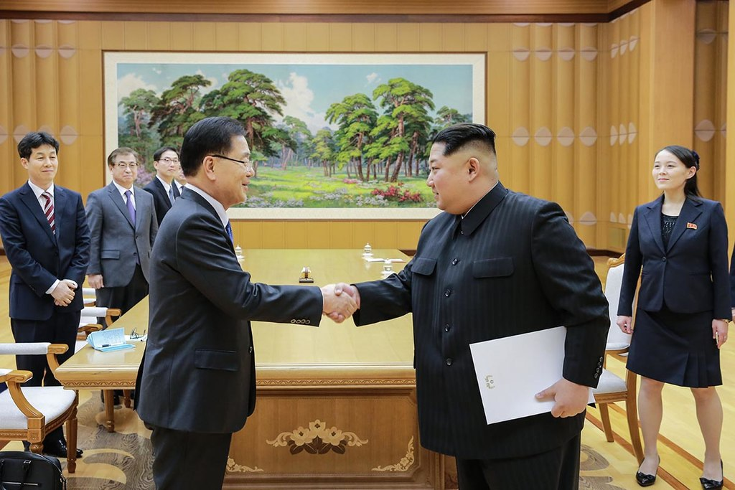
Chŏng Ŭi-yong with Kim Jŏng-ŭn, March 5, 2018

Slide 16
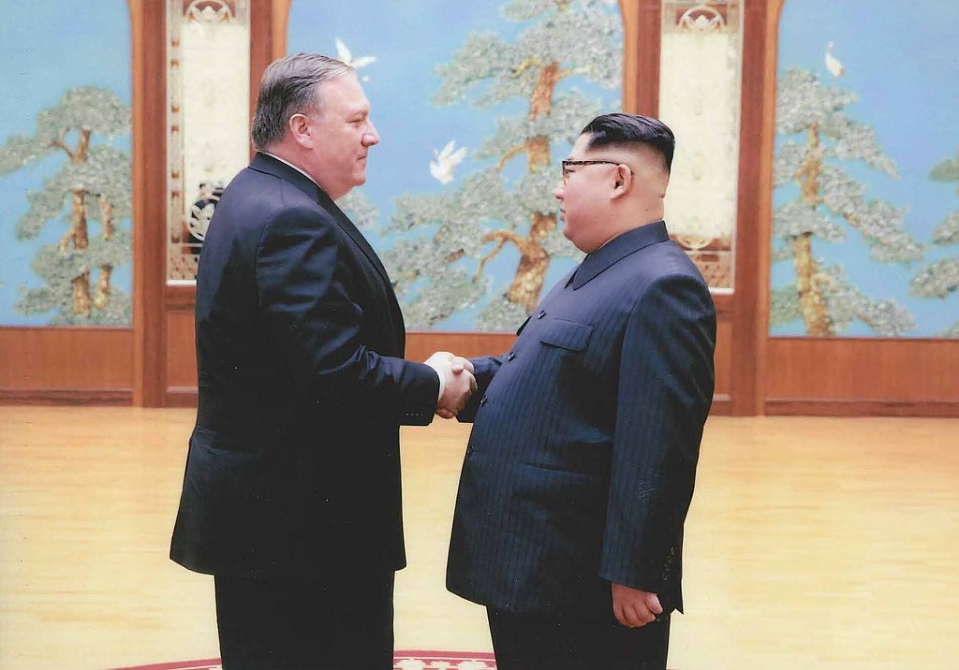
Kim Jŏng-ŭn with Mike Pompeo in Phyongyang, 31 / 03 / 2018

Slide 17
Kim Jong-un's meeting with Xi Jinping
North Korea's supreme leader Kim Jŏng-ŭn was in Beijing on March 25–28, 2018, arriving by special train for talks with China's paramount leader Xi Jinping (习近平), Kim's first known out-of-country excursion since taking power six years previously. China stated that North Korea was "committed to denuclearization" and willing to hold a summit with the United States. It was organized by the invitation of Xi. During the meeting between two leaders, Kim officially invited Xi to the North Korean capital Phyŏngyang when it was convenient in his schedule, and Xi accepted the invitation.
Xi urged Kim to strengthen the strategic and diplomatic future partnership between China and North Korea. Kim stressed to Xi that North Korea and China are communist countries and that there are many ways to cooperate in various aspects in the future. Kim and Xi met again on May 7, 2018, in the city of Dalian (大连), China.

Slide 18
Proposed conditions by North Korea
On April 11, North Korea presented five entreaties as conditions for the dismissal of their nuclear-capable ICBMs:
Ensuring the United States and South Korea do not locate nuclear weapons strategic assets within the vicinity of the Korean Peninsula.
Ceasing development or operation of strategic nuclear assets during USFK-ROK combined military training.
Ensuring the United States will not attack North Korea with conventional or nuclear weapons.
Converting the 1953 Korean Armistice Agreement into a peace treaty on the Korean Peninsula
Establishing official diplomatic ties between North Korea and the United States.
Although North Korea was previously expected to request the withdrawal of (USFK) from South Korea, North Korea publicized they would embrace the continuous deployment of 25,000 USFK troops in South Korea as long as the security of North Korea is guaranteed.

Slide 19
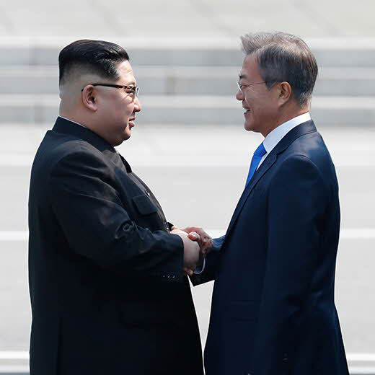
April 2018 inter-Korean summit
At an inter-Korean on April 27, 2018, held at the Peace House in Phanmunjŏm, the leaders of North and South Korea agreed to formally end the Korean War before the end of the year and confirmed the goal of a nuclear-free Korean Peninsula through denuclearization.

Slide 20
Tensions, cancelation, and reinstatement
American Vice President Mike Pence said on May 21, 2018, that "this will only end like the Libyan model ended if Kim Jong-un doesn't make a deal" to "dismantle his nuclear weapons program". Trump had made similar remarks on May 17, as he described that Libya's fate is "what will take place if we don't make a deal". These comments were in reference to the killing of Libyan leader Mu’ammar Qaḍḍafi (معمر القذافي) after military intervention by Americans and Europeans in 2011. After a NATO airstrike prevented Qaddafi's escape, the Libyan rebels captured, assaulted, sodomized, and executed Qaddafi. However, Libya under Gaddafi had already in 2003 voluntarily ended its nuclear weapons program and complied with conditions set by Western powers. As a result, North Korean vice foreign minister Choe Sŏn-hŭi (최선희) called Pence's remarks "ignorant and stupid" and threatened a "nuclear-to-nuclear showdown".
Trump canceled the summit on May 24, 2018, via a letter to Kim Jŏng-ŭn, writing that "based on the tremendous anger and open hostility displayed in your most recent statement, I feel it is inappropriate, at this time, to have this long-planned meeting ... You talk about your nuclear capabilities, but ours are so massive and powerful that I pray to God they will never have to be used." Even though it was Trump who decided to cancel, Trump told Kim, "If you change your mind having to do with this most important summit, please do not hesitate to call me or write."
South Korean President Moon was left "very perplexed" by Trump's cancellation, while the South Korean minister in charge of inter-Korean affairs Cho Myoung-gyon said that North Korea "remains sincere" on "efforts on denuclearization and peace building".

Slide 21
Tensions, cancelation, and reinstatement
In response to Trump's cancellation, North Korean vice foreign minister Kim Kye-gwan (김계관) expressed his country's "willingness to sit down face-to-face with the US and resolve issues anytime and in any format", being "open-minded in giving time and opportunity to the US" for the "peace and stability for the world and the Korean Peninsula".
Trump's cancellation had come on the day North Korea had detonated explosives at its only known nuclear test site at Punggye-ri (풍계리핵실험장) in front of international journalists; North Korea claimed that this would have demolished the test site.
On May 25, however, Trump announced that the summit could resume as scheduled following a "very nice statement" he received from North Korea and that talks were now resuming.
On May 30, North Korean general Kim Yŏng-chŏl arrived in New York City to meet with US Secretary of State Mike Pompeo. Negotiations between Kim and Pompeo continued the next day, and Pompeo later stated at a press conference that "good progress" had been made. Kim Yŏng-chŏl , who was the vice chairman of Central Committee of the Workers’ Party of Korea, was the highest-ranking North Korean official to visit the US since 2000, when Jo Myŏng-rok (조명록) had met with US president Bill Clinton in Washington, D. C.
On June 1, Trump announced the summit would resume as scheduled for June 12 after he met Kim Yŏng-chŏl at the White House.

Slide 22
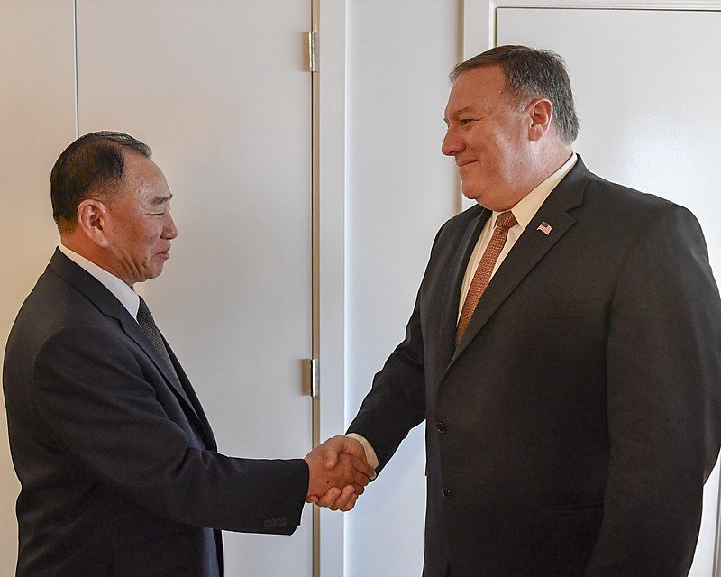
Kim Yŏng-chŏl and Mike Pompeo

Slide 23
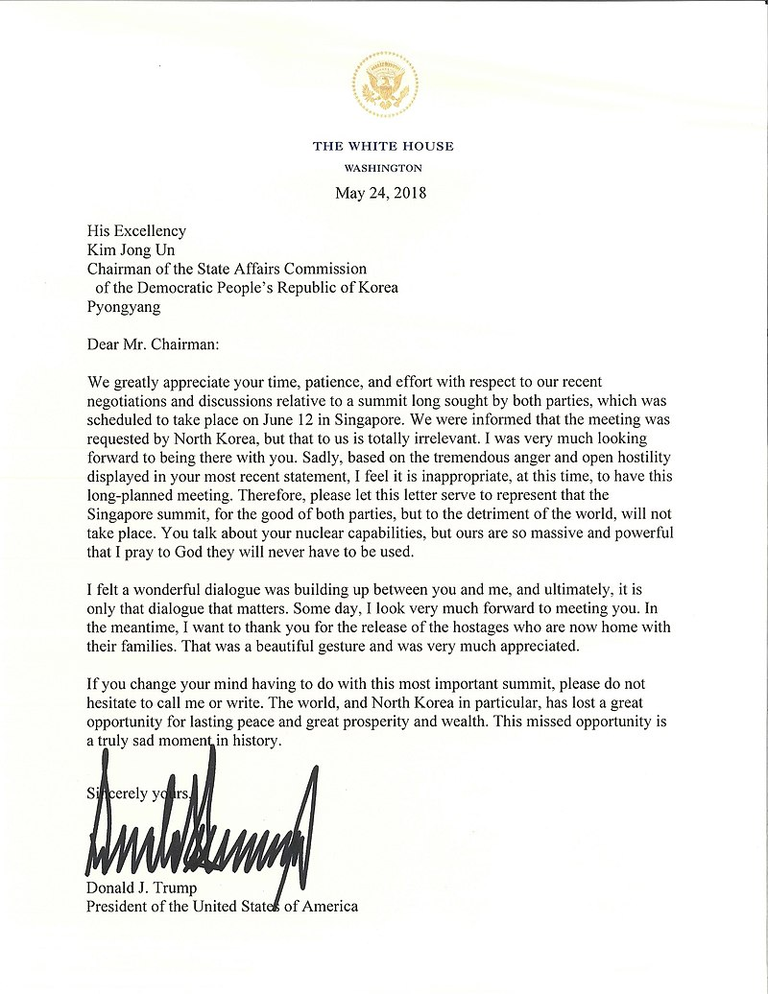
Letter sent to North Korean leader Kim Jong-un by US President Donald Trump informing Kim of the cancellation of the summit

Slide 24
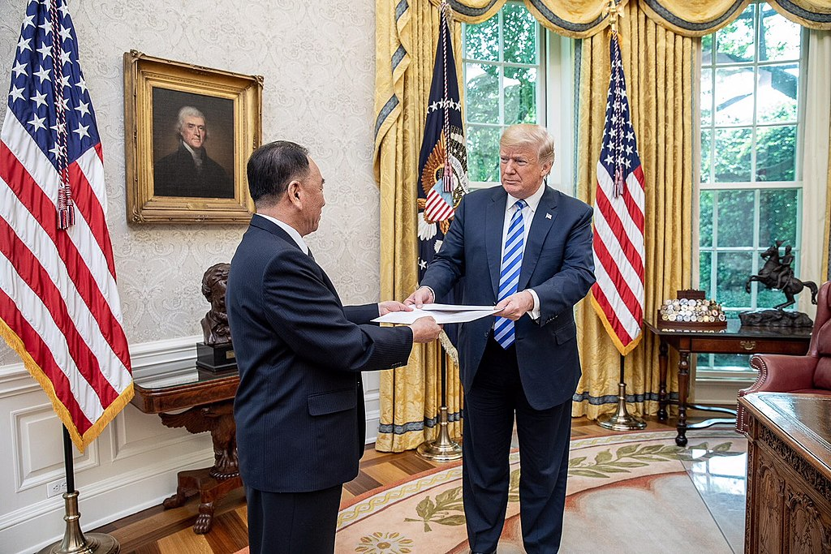
Kim Yŏng-chŏl delivers a personal letter from Kim to Trump, in the White House Oval Office on June 1, 2018

Slide 25
Potential denuclearization process
During president Donald Trump's meeting with North Korea envoy, the former spy chief Kim Yŏng-chŏl at the White House, Trump said that he would choose the "denuclearization process" in North Korea. The nuclear warheads and the ICBM nuclear missiles completed in North Korea could be transferred outside of North Korea and economic sanctions on North Korea could be partly alleviated. The next step would be comprehensive inspections on North Korea's nuclear facilities and nuclear ICBM weapons program by IAEA.
On July 7, 2018, U.S. Secretary of State Mike Pompeo, Japanese Foreign Minister Kōno Tarō (河野太郎) and South Korean Foreign Minister Kang Kyung Wha (강경화) met in Tokyo, where they reaffirmed their unity in urging North Korea to denuclearize as promised. The ministers stressed the need to call on North Korea to take concrete steps toward denuclearization and to keep existing U.N. economic sanctions in place.
Ten days later, Donald Trump said there is "no time limit" for North Korea to denuclearize and that there is no need to rush the process.

Slide 26
US–South Korea summit
On May 22, 2018, South Korea president Mun Jae-in visited the United States to meet President Trump, to promote Trump-Kim summit progress, and to coordinate the two countries' common strategy regarding the upcoming summit, following harsh rhetoric from North Korea towards Washington.
On 12 May 2018, North Korea announced the closure and planned dismantlement of its Punggye-ri Nuclear Test Site, and invited journalists to witness the destruction of its tunnels and other testing infrastructure.
North Korea shut down its Punggye-ri nuclear test site on May 23, 2018, to demonstrate its commitment to denuclearization. The South Korean government welcomed the DPRK's unilateral nuclear concession to help facilitate a broader agreement with the United States to completely end its nuclear weapons program.
On 24 May 2018, reporters witnessed explosions to purportedly close those tunnels, although independent inspectors were not present. Those explosions destroyed the portals to several test tunnels, but the extent of the damage to the tunnels themselves was not clear.

Slide 27
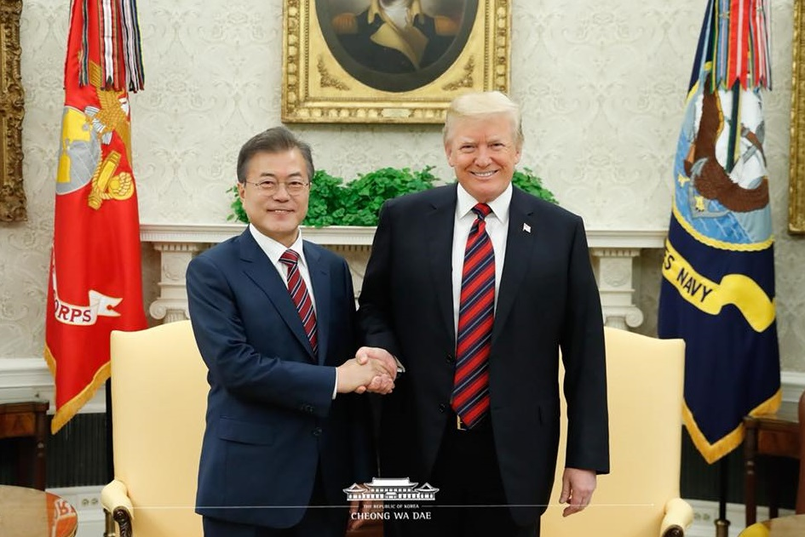
Mun Jae-in in Washington, May 22, 2018

Slide 28
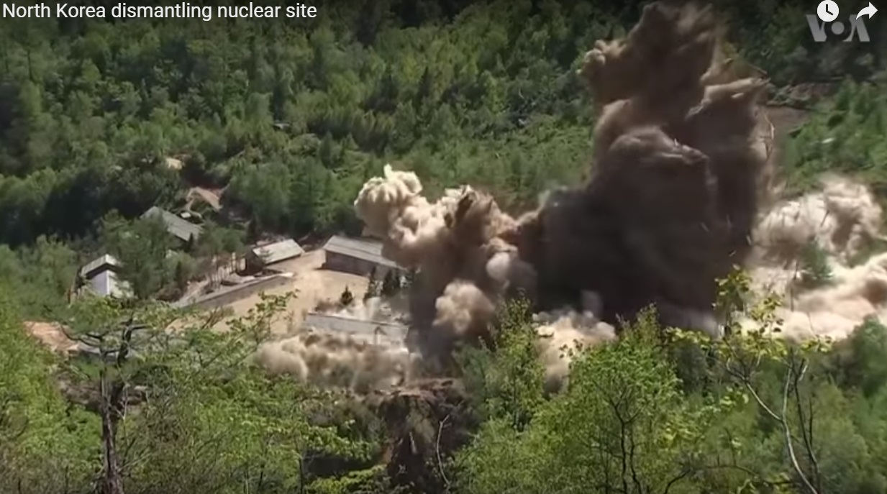
Dismantlement of the Punggye-ri Nuclear Test Site

Slide 29
May 2018 inter-Korean summit
Two leaders of North and South Koreas exchanged their opinions about the issues and solutions for the Trump-Kim summit as Trump abruptly cancelled the upcoming US-North Korea summit on 12 June. The principal agenda of the meeting was trying to get U.S. summit back on track and keep progressing the denuclearization talks.
The second 2018 summit was established by Kim Jŏng-ŭn's suggestion within a whirlwind 24 hour notice, but Mun Jae-in accepted Kim's invitation as per the critical nuclear agenda between North and South Korea. Mun Jae-in had expressed his belief, and he discussed with Kim Jŏng-ŭn about Kim's willingness to join nuclear interventions with Trump. Both leaders also agreed to accelerate the implementation of the Phanmunjŏm Declaration and meet again at "anytime and anyplace" without formality.

Slide 30
Preparations for the North Korea – U. S. summit
Kim flew to Singapore on a Boeing 747 operated by Air China, a plane used by the highest echelons of the Chinese leadership. According to media reports, a cargo plane, an Air Koryo Ilyishin Il-76, containing food items and other perishables landed in Singapore from North Korea before Kim's plane landed. Chiller trucks ferried them to the St. Regis Hotel Singapore where Kim stayed. A third plane from North Korea, an Air Koryo Ilyushin Il-62, landed shortly afterward; Kim's sister and vice director of the Propaganda and Agitation Department, Kim Yŏ-jŏng , was believed to be on board.
Singapore Prime Minister Lee Hsien Loong (Li Xianlong / 李显龙) visited the summit's International Media Centre on June 10 when it opened. At a media conference, Lee mentioned that the summit cost S$20 million, with security costs taking up S$10 million and the setting up of the International Media Centre costing S$5 million, but it is a cost that Singapore is "willing to pay".

Slide 31
The North Korea – United States summit
United States President Donald Trump arrived at Capella Hotel first before North Korean leader Kim Jong-un arrived seventeen minutes later. They started the summit at 9:05 am local time with a 12-second handshake and then participated in a one-on-one meeting, with interpreters only. Trump and Kim emerged from the one-on-one talks and walked down the corridor to the Cassia where the expanded bilateral meeting took place. Trump described the one-on-one meeting as "very very good" when asked by a reporter.
When Trump was asked if he had notes of the one-on-one meeting to refer back and verify, Trump replied, "I don't have to verify because I have one of the great memories of all time".
Both countries' delegations proceeded to participate in an expanded bilateral meeting and a working lunch.
Subsequently, Trump and Kim signed a joint statement, titled "Joint Statement of President Donald J. Trump of the United States of America and Chairman Kim Jŏng-ŭn of the Democratic People's Republic of Korea at the Singapore Summit", which Trump described as a "very important" and "comprehensive" agreement.

Slide 32
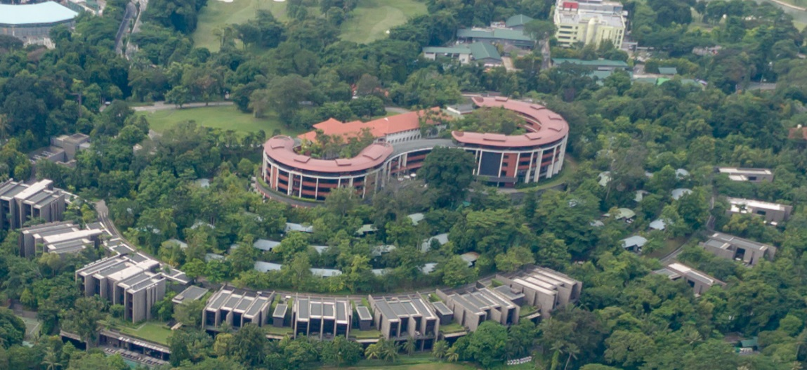
The Capella Hotel, Singapore

Slide 33
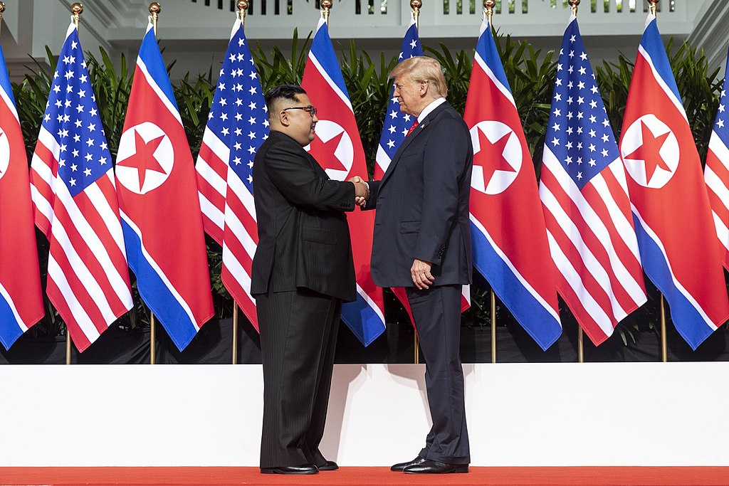
Singapore, June 12, 2018 – the handshake

Slide 34
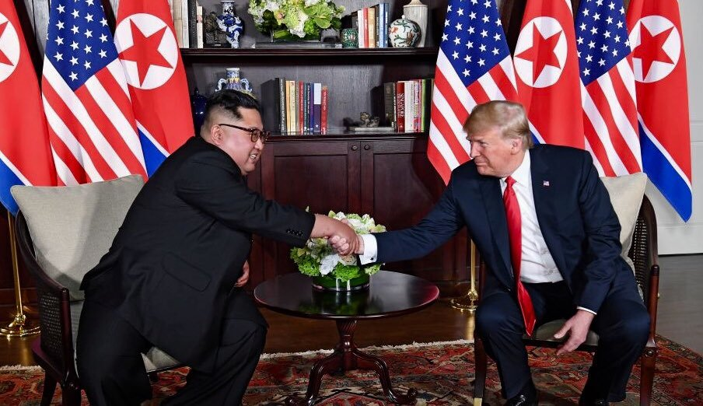
The one-on-one meeting

Slide 35
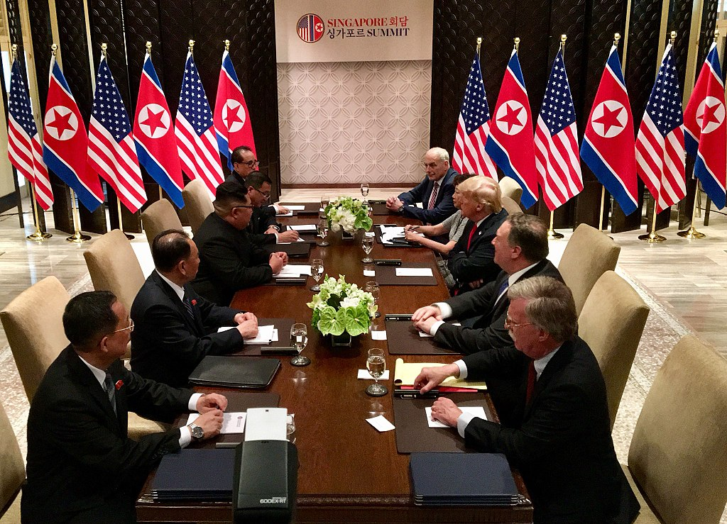
Expanded bilateral meeting – full delegations, 12 / 06 / 2018

Slide 36
The Joint Statement
The document said:
"President Trump and Chairman Kim Jŏng-ŭn state the following:
The United States and the DPRK commit to establish new U.S.-DPRK relations in accordance with the desire of the peoples of the two countries for peace and prosperity.
The United States and the DPRK will join their efforts to build a lasting and stable peace regime on the Korean Peninsula.
Reaffirming the April 27, 2018 Phanmunjŏm Declaration, the DPRK commits to work towards the complete denuclearization of the Korean Peninsula.
The United States and the DPRK commit to recovering POW / MIA (prisoners of war / missing in action) remains including the immediate repatriation of those already identified.
In addition to the numbered provisions, the joint statement also mentions Trump's commitment to providing security guarantees to North Korea. Follow-up negotiations between Pompeo and an undetermined high-level North Korean official are also called for by the joint statement”.

Slide 37
Trump on the summit
Trump held a news conference at 16:15 local time which lasted for more than an hour. In his news conference, Trump said that further discussions will take place with North Korean officials and that he would consider visiting Pyongyang. Referring to his commitment in the Joint Statement to "provide security guarantees" to North Korea, Trump announced the end of the joint military exercises with the South Korean military, which he described as "provocative". U.S. Forces in Korea and South Korea were apparently not consulted. He expressed his hope that the removal of 32,000 American troops defending South Korea would become part of the equation. The next round of joint military exercises was scheduled for late August.
Upon returning to the United States the following day, President Trump declared that North Korea was no longer a nuclear threat. On June 22, 2018, Trump provided a "Notice Regarding the Continuation of the National Emergency with Respect to North Korea," which extended the Executive Order 13466 of 2008 by one year, reaffirming "the current existence and risk of the proliferation of weapons-usable fissile material on the Korean Peninsula constitute an unusual and extraordinary threat to the national security and foreign policy of the United States, and I hereby declare a national emergency to deal with that threat."

Slide 38
Aftermath
The DPRK has shown eight or more types of various actions on their portion of the agreement, among them: 1) a moratorium on missile/nuclear tests, 2) dismantling the Sŏhae atomic test and satellite launch site, 3) the shutting down of an intercontinental ballistic missile assembly facility near Pyongyang, 4) the returning of the remains of 55 U.S. soldiers killed in the Korean War, 5) the removal of domestic anti-American propaganda, and 6) the release of three American Citizens arrested and imprisoned in the DPRK, as North Korean action items of the summit. However, the US has thus far taken only one action, i. e. the cancelling of joint military exercises between the US and South Korean Air Forces in the peninsula.
Removed anti-American propaganda in DPRK: The DPRK government toned down aspects of its anti-American propaganda after the Singapore summit, with many anti-American posters being removed in the capital to give way to less politicized messages. The government also cancelled North Korea's annual "anti-US imperialism" rally on July 27th, 2018, a national holiday commemorating the start of the Korean War.

Slide 39
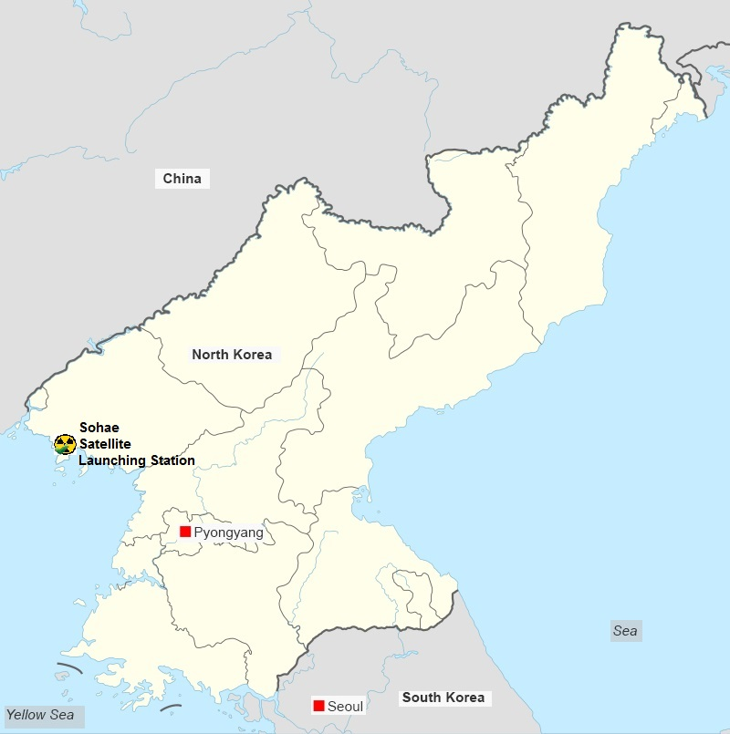
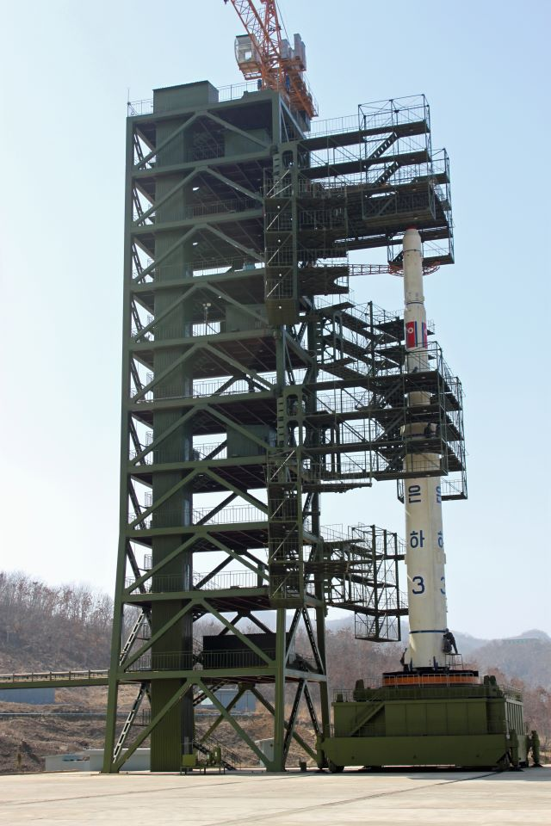
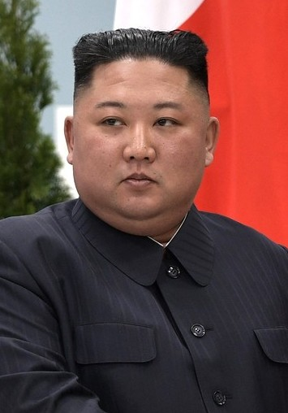

Slide 40
State secretary Pompeo on North Korean actions
US Secretary of State Mike Pompeo has made a request for North Korea to hand over 60 to 70 percent of its nuclear arsenal within six to eight months. However, the DPRK has not yet accepted that proposal. The North Korean foreign minister Ri Yong-ho released an announcement criticizing unilateral denuclearization, and emphasized that it is only equitable to perform a “balanced, simultaneous, step-by-step implementation” of the US-DPRK Joint Statement.
On July 6–7, Pompeo travelled to North Korea for the third time to continue the negotiations with Kim Yŏng-chŏl, "a senior official who has been [North Korea's] point person in deliberations with the United States, South Korea and China". After the meeting, Pompeo said that the talks were productive and that progress had been made "on almost all of the central issues". However, North Korean state media criticized the meeting soon after, saying the U.S. had shown a "gangster-like attitude" and calling the demands of the Trump administration "deeply regrettable". Notwithstanding the stern reports, Pompeo delivered a letter from Kim to Trump, in which the latter expressed his hope for successful implementation of the US-North Korea Joint Statement and reaffirmed his will for improving the relations between the countries.

Slide 41
Shutdown of ICBM assembly facility and destruction of missile test site
The Voice of America (VOA) reported on July 25 that there is evidence that North Korea has dismantled an intercontinental ballistic missile (ICBM) construction facility near Phyongyang. It was confirmed by analyzing satellite images taken around the March 16 with the latest satellite images in July. It was the investigated place of the factory that the Hwasong-15 ICBM that North Korea test-launched on November 29, 2017, was assembled at this plant and then moved on a transporter-erector-launcher (TEL).
On July 24, it was reported that North Korea had begun to dismantle a rocket launching and testing site near Tonchang, an action which Kim had pledged to Trump. South Korean President Moon called the move "a good sign for North Korea’s denuclearization". The North Korea monitoring specialist group 38 North found that the Sŏhae Station, a satellite-launch site in North Korea, was being demolished. Satellite imagery shows that several significant structures were destroyed: a missile-launching stand and a building near a launchpad for satellites. 38 North suggested that it is an essential beginning step towards achieving a commitment made by Kim Jŏng-ŭn at the June 12 Singapore Summit. On 7 August, there is more progress on Dismantling Facilities at the Sŏhae atellite and Missile Launching Station. it entails the demolition of the test stand's concrete foundations, launch pad's gantry tower and pad foundation, etc.

Slide 42
North Korean deceit
On June 30, NBC reported that, according to an assessment by the U.S. intelligence agencies, North Korea might have increased production of fuel for nuclear weapons at multiple secret sites after the summit, though if the process of enrichment had occurred, it must have begun before the summit. On August 3, experts monitoring U.N. sanctions against North Korea sent a report to the UN Security Council saying North Korea "has not stopped its nuclear and missiles programs" and is still violating sanctions by transferring coal at sea and flouting an arms embargo and financial sanctions. However, North Korean Foreign Minister Ri-Yong Ho said in a privilege speech at the ASEAN summit, that a “good-faith implementation of the Joint Statement (between the USA and DPRK) would be necessary”. Referring to this same speech, the North Korea monitoring specialist Group, 38 North, believes that in order to achieve the goal to denuclearize, a scheme of ALL TAKE-NO GIVE will never work with DPRK.
The New York Times reported on November 12, 2018 that "satellite images suggest that the North has been engaged in a great deception" by offering to dismantle one missile launch site while continuing to develop sixteen others. The Times reported that American intelligence had determined that North Korea's production of fissile material, nuclear weapons and mobile missile systems had continued since the summit, adding that the missile network was "long known to American intelligence agencies but left undiscussed as President Trump claims to have neutralized the North’s nuclear threat." The following day, Trump called the report of North Korea developing missile sites "inaccurate" and "just more fake news," adding "We fully know about the sites being discussed, nothing new." The Times stood by the accuracy of its report. On November 13, 2018, Kim Ŭi Kŭm, a spokesman for South Korean President Mun Jae-In, described the report and images as "nothing new" and further stated that North Korea "has never signed any agreement, any negotiation that makes shutting down missile bases mandatory."
CNN acquired satellite images in December 2018 that indicated North Korea was continuing to significantly expand a major long-range missile site in the mountainous interior of the country, including an "extremely large underground facility" that could be under construction as of August 2018.

